Slide 1
File Handling – FILE I/O Reading and Writing Objects from / to Files
Carole McGloughlin
Frances Sheridan

Slide 2
Worked Example
The remainder of the slides will cover the method we will use to read / write text to a file. We will cover a method for:
Writing objects to a file
Reading objects from a file
By objects we mean the content of an Instantiable class. We will look at writing and reading a single object and then an array / arrayList of objects to / from a file

Slide 3
Step 1: Serializable
To write and read objects to/from files we must first make the class serializable.
Serializable is an Interface and java needs to know where to find it.
No other changes are needed in the instantiable class.
public class Employee implements Serializable{
….
}
import java.io.Serializable;

Slide 4
Step 2: Writing Objects to a File
Import the correct java package. All of the packages are in the java.io package. If we don’t know the name of the class we can import the entire class.
However, it is far more efficient to import the classes we actually use. Since we are writing objects to a file, we use a different set of classes than writing text to a file.
import java.io.*;
import java.io.File;
import java.io.FileOutputStream;
import java.io.ObjectOutputStream;

Slide 5
Step 2: Writing Objects to a File
Open a file pointer. Tell Java where the file is and what it is called.
If the file is in the same directory, we simply specify the name of the file.
The file should have the file extension .dat or .data to store objects
If the file is location elsewhere we also specify the path to the file. Note: the double \\
File f = new File (“output.dat”);
File f = new File (“C:\\myfolder\\somewhere\\output.dat”);

Slide 6
Step 2: Writing Objects to a File
Open a FileOutputStream object and pass the file pointer to it.
This opens a data stream to the specified file, which allows us write the object to the file.
FileOutputStream oStream = new FileOutputStream (f);

Slide 7
Step 2: Writing Objects to a File
Open a ObjectOutputStream object.
This takes the FileOutputStream object as a parameter and writes the actual object to the file.
ObjectOutputStream outputStream = new ObjectOutputStream (oStream);

Slide 8
Step 2: Writing Objects to a File
The actual writing is done using the writeObject () method.
After we have finished writing using the close() method, we close the file stream.
outputStream.writeObject(e);
outputStream.close();

Slide 9
What if the File is corrupted or does not exist?
In the case of writing to a file, if the file does not already exist, Java will create it for you.
However, the file could get corrupted or not be writable for some reason.
We always try to write to a file, but have a clause in case something goes wrong. This is known as a try-catch.
All our File IO code is surround by a try{ }
This is following by catch(IOException e){ }
IOException is a class that watches for problems associated to reading / writing to a file.
We normally print out the exception that is caught and print our own meaningful message.

Slide 10
try-catch
try {
File outFile = new File ("output.data");
FileOutputStream oStream = new FileOutputStream (outFile);
ObjectOutputStream outputStream = new ObjectOutputStream (oStream);
outputStream.writeObject(e);
outputStream.close();
}
catch (IOException ex) {
System.out.println (ex);
}

Slide 11
Step 2: Writing Objects to a File
Working with the last Employee Application, we will amend the functionality that writes the text to a File, to write the entire array of objects/ arrayList of objects to the file.
Download the EmployeeFileIOApp.zip from Moodle. Unzip it and rename to EmployeeFileIOObjectApp
Open up the project in netbeans
Right click on the project name, and rename to EmployeeFileIOObjectApp
Expand the source Packages and refractor and rename the package to employeefileioobject
Right click on the Project name and go to Properties, in the Run category make sure the main class is correct.
You may need to amend the package name.

Slide 12
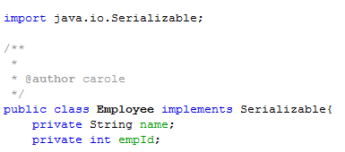
Instantiable Classes
Open each of the instantiable classes in turn and make them Serializable.
For example, in Employee.java we add the following import statement and change to the class header

Slide 13

EmployeeGUI.java
Open EmployeeGUI.java
In the design palette, double click the “Write to File” go to the writeJBActionPerformed method.
We want to amend this method to write the individual objects to the file:
First set up the File objects
You will notice they are all underlined in red
Right click on each, and select Fix imports
This should be surrounded in a try - catch

Slide 14
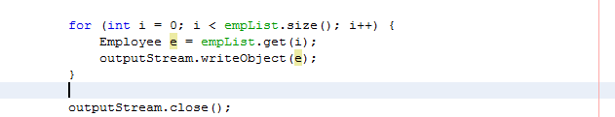
writeJBActionPerformed
Loop around the ArrayList of objects, pop each object from the array list
Write the object to the file
Then close the ObjectOutputStream

Slide 15
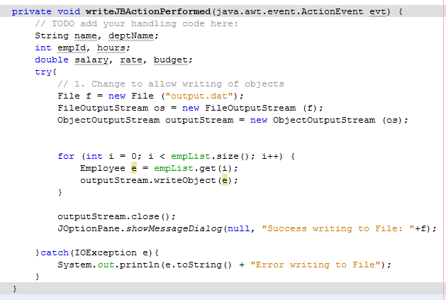

Slide 16
Step 3 - Reading Objects from a File
Import the correct java package. All of the packages are in the java.io package. If we don’t know the name of the class we can import the entire class.
However, it is far more efficient to import the classes we actually use.
import java.io.*;
import java.io.File;
import java.io.FileInputStream;
import java.io.ObjectInputStream

Slide 17
Step 3 - Reading Objects from a File
Open a file pointer. Tell Java where the file is and what it is called.
If the file is in the same directory, we simply specify the name of the file.
The file should have the file extension .dat or .data to store objects
If the file is location elsewhere we also specify the path to the file. Note: the double \\
File f = new File (“input.dat”);
File f = new File (“C:\\myfolder\\somewhere\\output.dat”);

Slide 18
Step 3 - Reading Objects from a File
Open a FileInputStream object and pass the file pointer to it.
This opens a data stream to the specified file, which allows us write to the file.
FileInputStream fStream = new FileInputStream(f);

Slide 19
Step 3 - Reading Objects from a File
Open a ObjectInputStream object.
This takes the FileInputStream object as a parameter and writes to the objects to the file.
ObjectInputStream iStream = new ObjectInputStream(fstream);

Slide 20
Step 3 - Reading Objects from a File
The actual reading is done using the readObject() method.
The method returns a String variable – to read a single line from a file:
In most cases there is more than one line to read from a file.
Often we do not know how many objects there are so we use a loop, testing for the object to be null each time
Employee e;
e = (Employee) iStream.readObject();
while (e != null) {
empList.add(e);
e = (Employee) iStream.readObject();
}

Slide 21
Step 3 - Reading Objects from a File
After we have finished writing using the close() method, we close the file stream.
iStream.close ();

Slide 22
What if the File is corrupted or does not exist?
If the File does not exist or is corrupted, we can’t read from it.
Again, we always try to read from a file, but have a clause in case something goes wrong – we use a try – catch
All our File IO code is surround by a try{ } which is followed by
catch(IOException e){ } and
catch(ClassNotFoundException ex) { }
We have to be careful to also check that the class has been defined – hence the additional catch clause.

Slide 23
What if the File is corrupted or does not exist?
try{
File f = new File ("output.dat");
FileInputStream inStream = new FileInputStream (f);
ObjectInputStream oStream = new ObjectInputStream (inStream);
Employee e = (Employee) oStream.readObject();
while (e != null) {
empList.add(e);
e = (Employee) oStream.readObject();
}
JOptionPane.showMessageDialog(null, "Success reading from File: "+f);
oStream.close ();
}catch (ClassNotFoundException ex) {
Logger.getLogger(EmployeeGUI.class.getName()).log(Level.SEVERE, null, ex);
}catch(IOException ex){
System.out.println(ex.toString() + "Error reading from File");
}

Slide 24
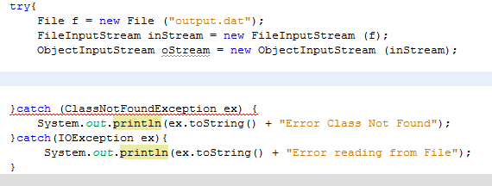
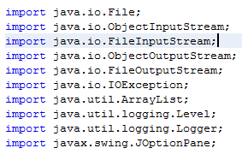
Step 3 - Reading Objects from a File
Continuing with the EmployeeFileIOObjectsApp example.
Back in the Design palette double click the “Load File” to bring us to the new loadJBActionPerformed method.
We want to amend this method to read all data that is stored in our file and populate an array of objects.
First set up the File objects and Fix imports

Slide 25
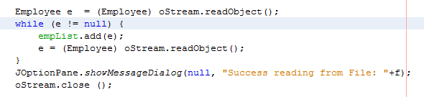
2. Reading Text from a File
Since each object is written separately, we use a while loop to get each element in the file and save to our arraylist.
Since we don’t want duplicate data, it might be nice to clear the array List before populating it. This can be done using the clear method before we read the details of the file.

Slide 26
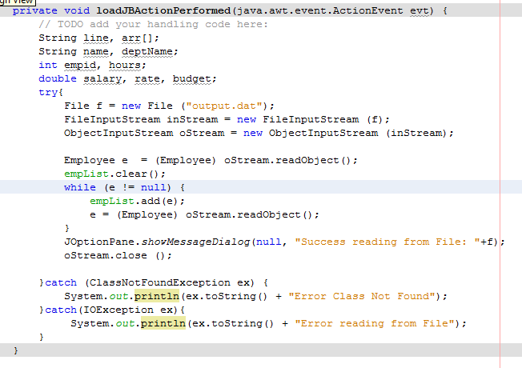

Slide 27
Notification of Successful I/O
Its worth adding some kind of print statement or message to show successful completion of File I/O.
For both read and write, a JOptionPane stating successful attempt completed was added to the actionPerformed methods.
For example,
JOptionPane.showMessageDialog(null, "Success reading from File: "+f);

Slide 28
Arrays/ArrayLists
It is possible to write the entire ArrayList (or Array) of objects to the file all at once and similarly to read the entire ArrayList (or Array) of objects from the file all at once.
This example given EmployeeFileIOArrayObjects project.
We simply omit the while loop and write or read the entire array all at once.

Slide 29
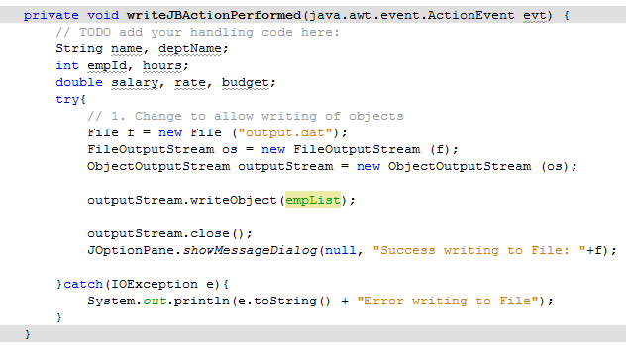
Writing ArrayList of Objects
To write an entire ArrayList of Object we do the following :
This is the only change

Slide 30
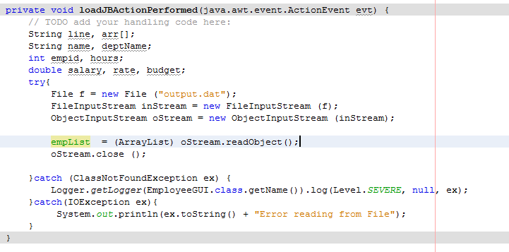
Reading ArrayList from a File
To read an entire ArrayList of Objects from a file we do the following :
This is the only change
Note: we cast as an ArrayList

